Slide 1
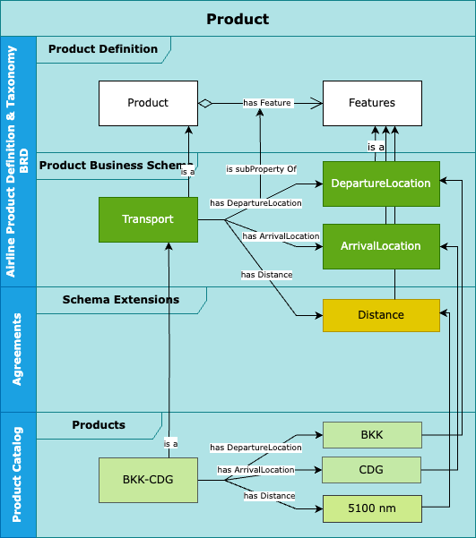
Product Definition
Describing product in the Retailer / Supplier for automated processing
Notes:
Solutioning :
Develop the grammar (in such a way that the schemas are void of interpretation, including on how to serialize the objects )
Develop the fully speced business schemas based on the grammar

Slide 2
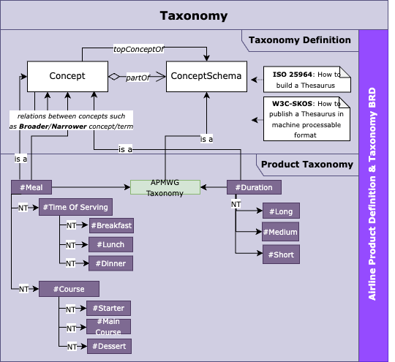
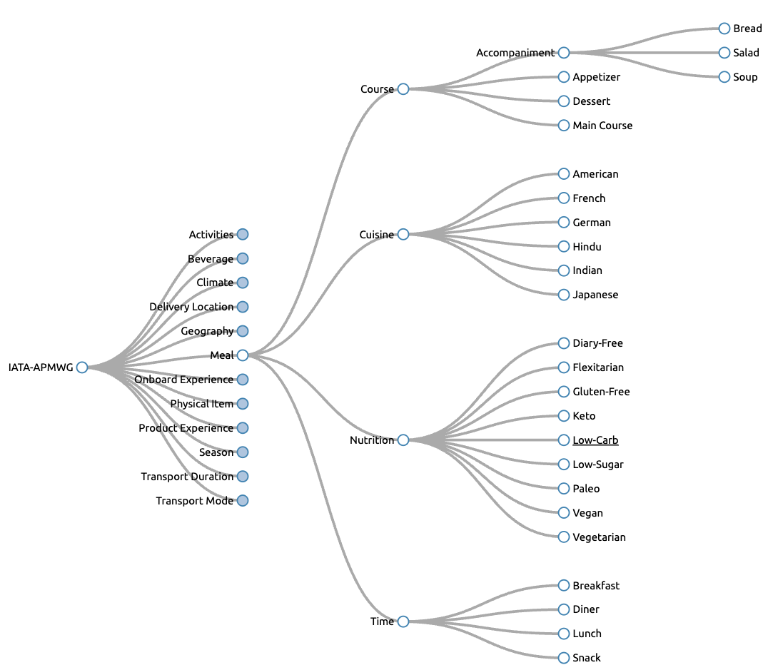
Taxonomy
Applied to the Retailer / Supplier model
Notes:
Solutioning: Implementation of the ISO standard ( own, choose from skos etc or something else in all cases we need a serialization of that as well and if possible a unique reference at IATA level to be referenced

